Slide 1
Projekt SQL
File created on: 4/14/2019 9:34:15 AM

Slide 2
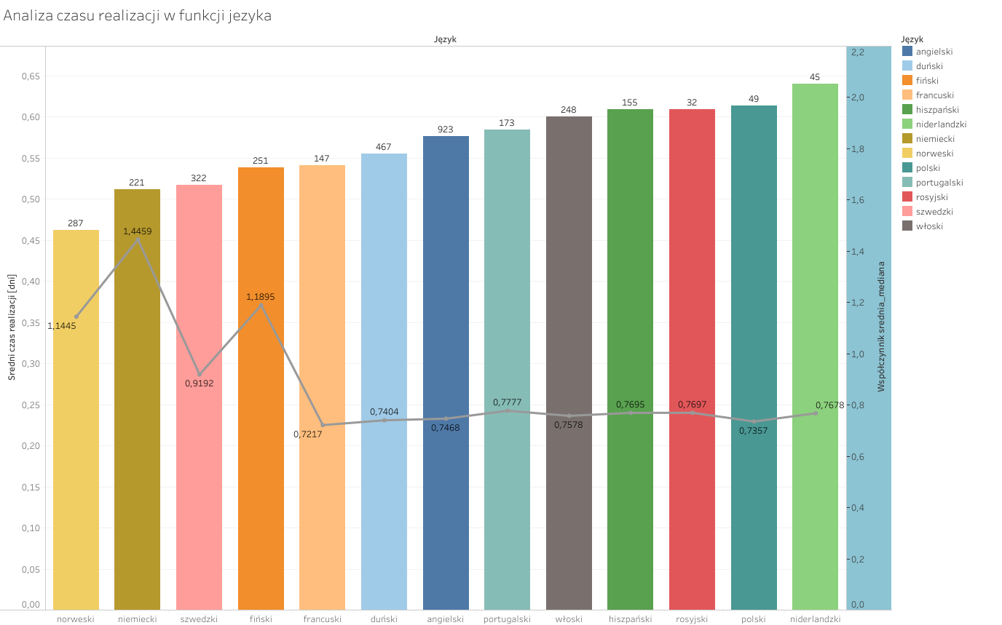

Slide 3
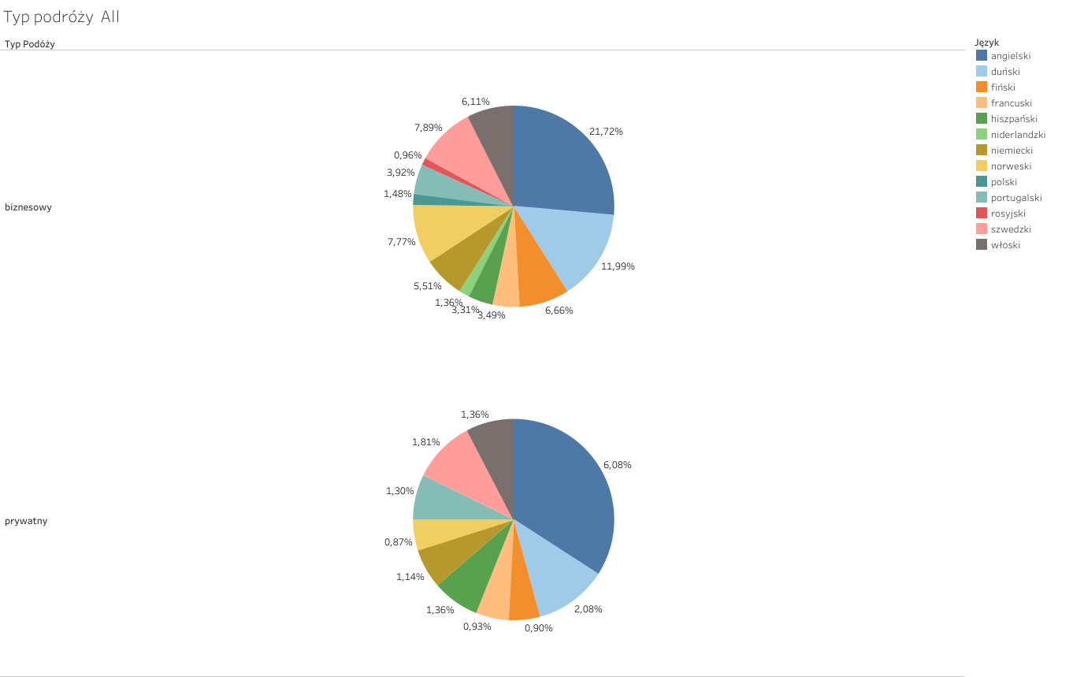

Slide 4
